Slide 1
S
SCM Software Lab
makes your business easy
http://www.scmsoftwarelab.com
Email : sales@scmsoftwarelab.com
+91 90524 31162 (INDIA)

Slide 2
Who we are?
We are professional cloud based iDempiere open source ERP consulting services providers. And we have developed 3PL & ERP products (as per industry standards) that can be easily customize as per your requirements. We also have experience on integrating iDempiere software with many third party software's (like, SAP, Shopify, Tally, DHL and etc.) and EDI.
OUR SERVICES
iDempiere Open Source ERP Consulting
OUR SOLUTIONS
Our Services includes.. Development, Functional Training, Technical Training and Customer Support.
Third Party Logistics Software (3PL with WMS)
Web Application Development
3PL / Fulfillment software will help logistics companies to handle Warehouse and Transportation services for their clients
We offers Cloud based Web Application Development services and it covers Custom software projects.
Enterprise Resource Planning Software (ERP with WMS)
Third Party Software Integration
ERP software will help trading and distribution companies to handle Procure to Pay & Order to Cash process.
We have experience on integrating iDempiere software with following third party software’s (like, SAP, Shopify, Tally, DHL and etc.) and Devices.

Slide 3
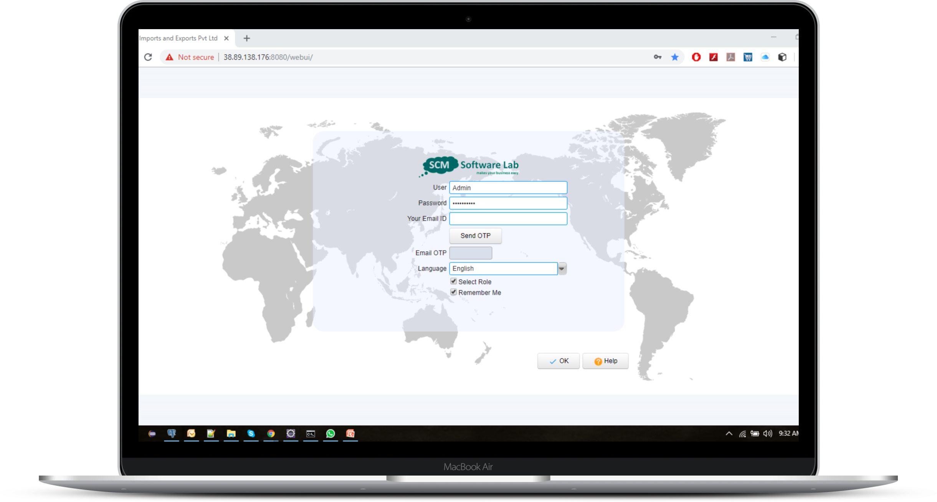
We provide Cloud 3PL Software

Slide 4
3PL Software - Key modules
Single software for your entire 3PL business
Following are the main modules of our 3PL system. Our software is 100% customizable as per your company requirements. And software is used by many large and medium scale business to solve their software problems in various departments and focus on their core business as well as reduce the cost of running their operations.
Inbound Operations
Warehouse Management System
Outbound Operations
Returns (Inbound / Outbound)
Vehicle Management
Accounting / Finance
Project Management
Vehicle Management
Business Intelligence / KPI Reports

Slide 5
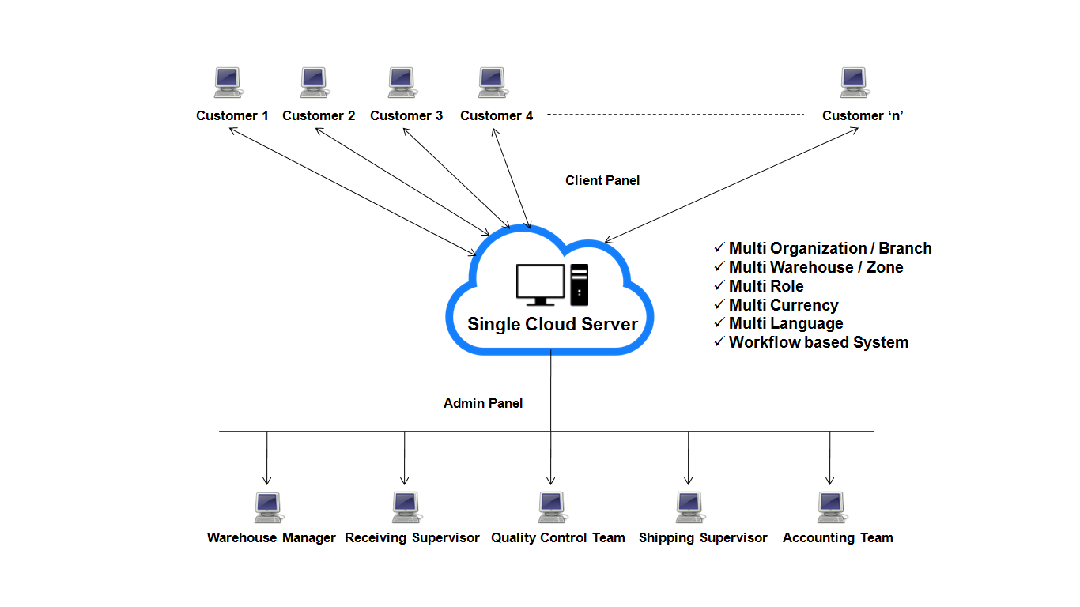
How Our 3PL Software Will Work?

Slide 6
Inbound Operations
6. Barcode Generation
1. Inbound Order
One Unique Barcode will be generate for each Received Material. This Barcode contains the Customer's Details, Item Name and etc...
Customer will raise request you to bring their Material in your Warehouse. This request we called as Inbound / Schedule Pickup Order
5. Upload Received Items Images
2. Schedule Pickup
During Quality Checking, User's can upload multiple Images of each Received Material in our 3PL software for future reference.
Pickup Department will prepare one Pickup Order / Note for bring Inbound Order materials from your Customers place to your Warehouse
4. Material Quality Check
3. Material Receipt
After Material unload into Receiving Bay, QC Department will check How much Qty Received & Material have any problems?
Once Truck come to your Warehouse along with Inbound Order Materials / Goods, Then Material will unload into Receiving Bay

Slide 7
Products
Customers
Inbound Operations Architecture
1. Customer will raise request you to bring their Material in your Warehouse. This request we called as Inbound / ASN Order
9. End Customer can raise Inbound Order based on Replenishment Report (System will suggest how much qty customer need to send Warehouse for maintaining stock levels)
Inbound Order (ASN Order)
Replenishment
2. Every day software will send email alerts to Pickup Department for “What materials needs to pickup today”
Pickup Required?
Schedule Pickup (Vehicle Management)
8. User can set Replenishment Rules to maintain Stock Ordering Levels (Minimum & Maximum On Hand Qty on Warehouse)
Yes
3.1 Pickup Department will prepare one Pickup Order / Note for bring multiple Inbound Order materials from multiple Customers place to your Warehouse
No
3. Once material come to your Warehouse, then material will unload into Receiving Bay. Then user will create Material Receipt Note for updating stock in Warehouse
7. Inventory Move used for moving material from one location to another location
5. If Quality Pass, then Material will move to actual Warehouse Locations
Material Receipt (GRN)
Quality Control
Putaway (Auto Bin Allocation)
Store Material in Warehouse Location
Pass
4. After Material unload into Receiving Bay, QC Department will check How much Qty Received & Material have any problems?
Failed
6. If Quality Failed, then Material will return to Customer
Receipt (QC) Confirmation
Inbound RMA
Inbound Order Return
End
Inventory Movement

Slide 8
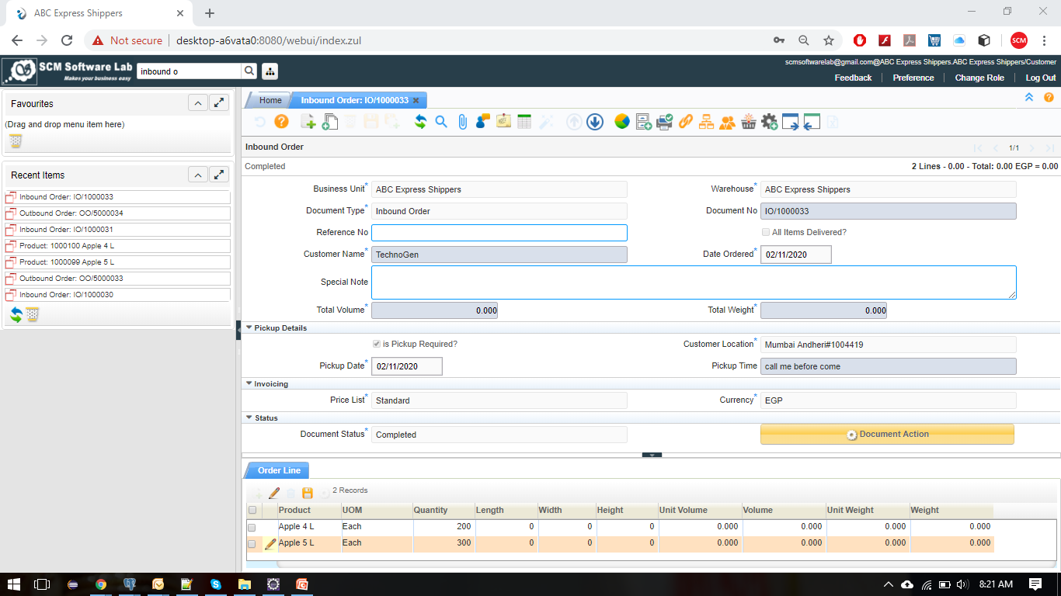
Inbound Order

Slide 9
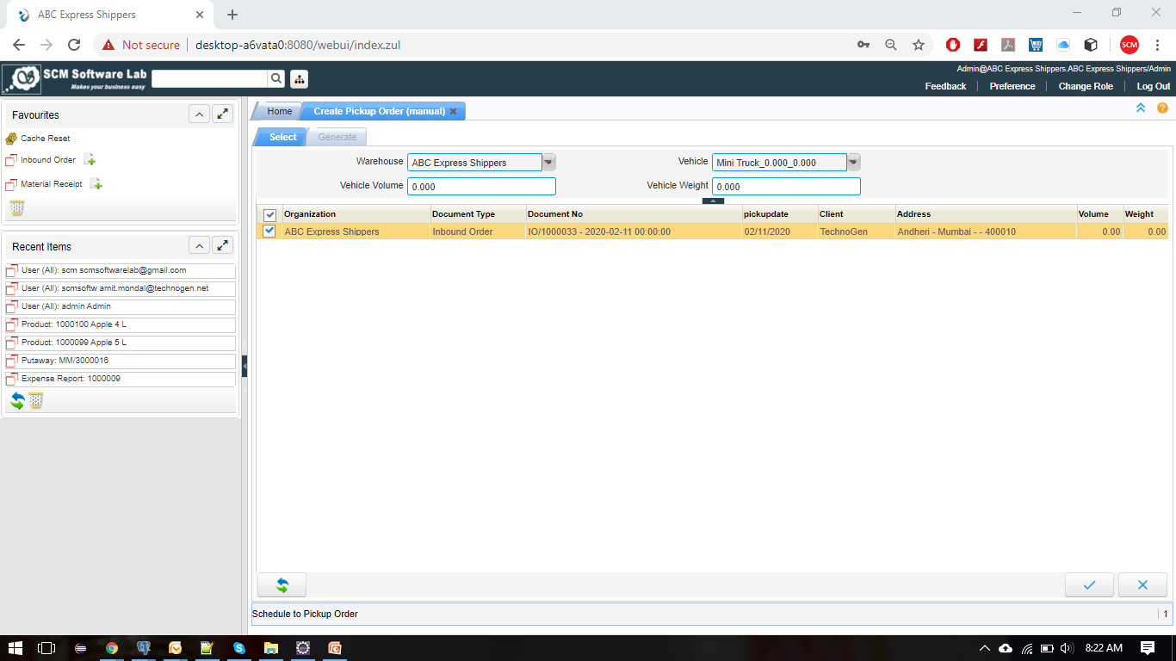
Schedule Pickup

Slide 10
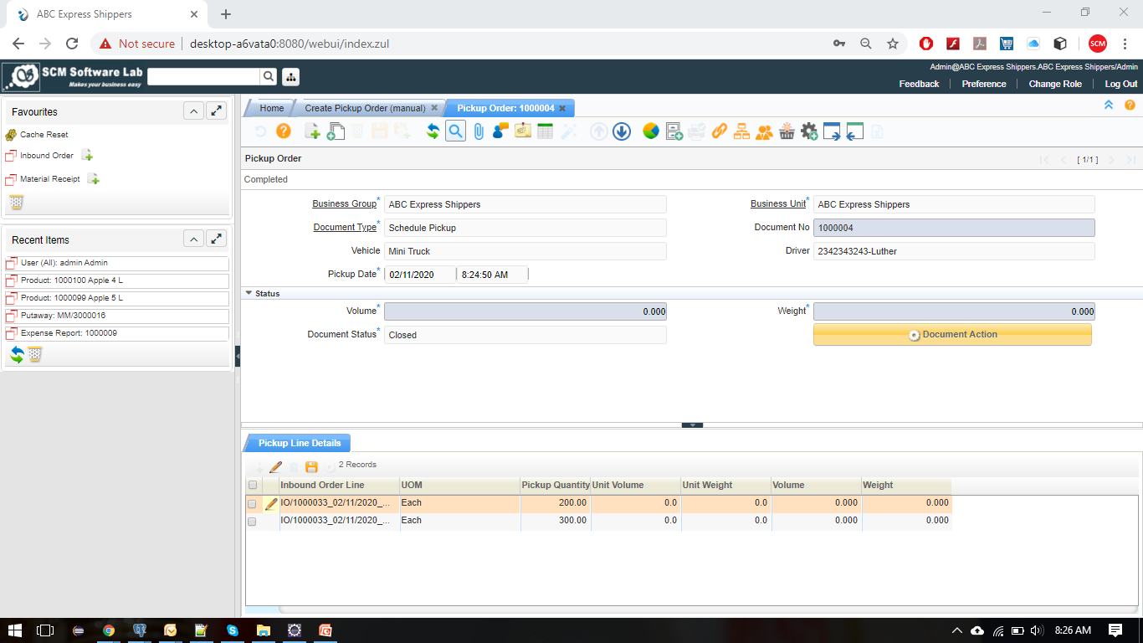
Schedule Pickup

Slide 11
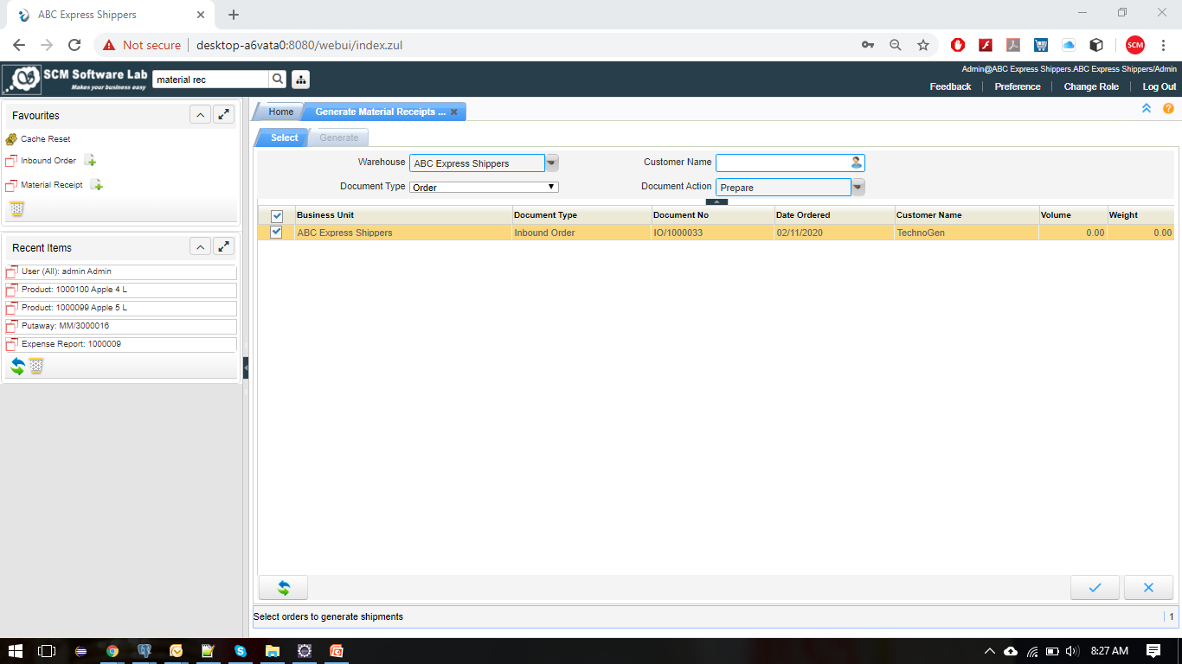
Material Receipt

Slide 12
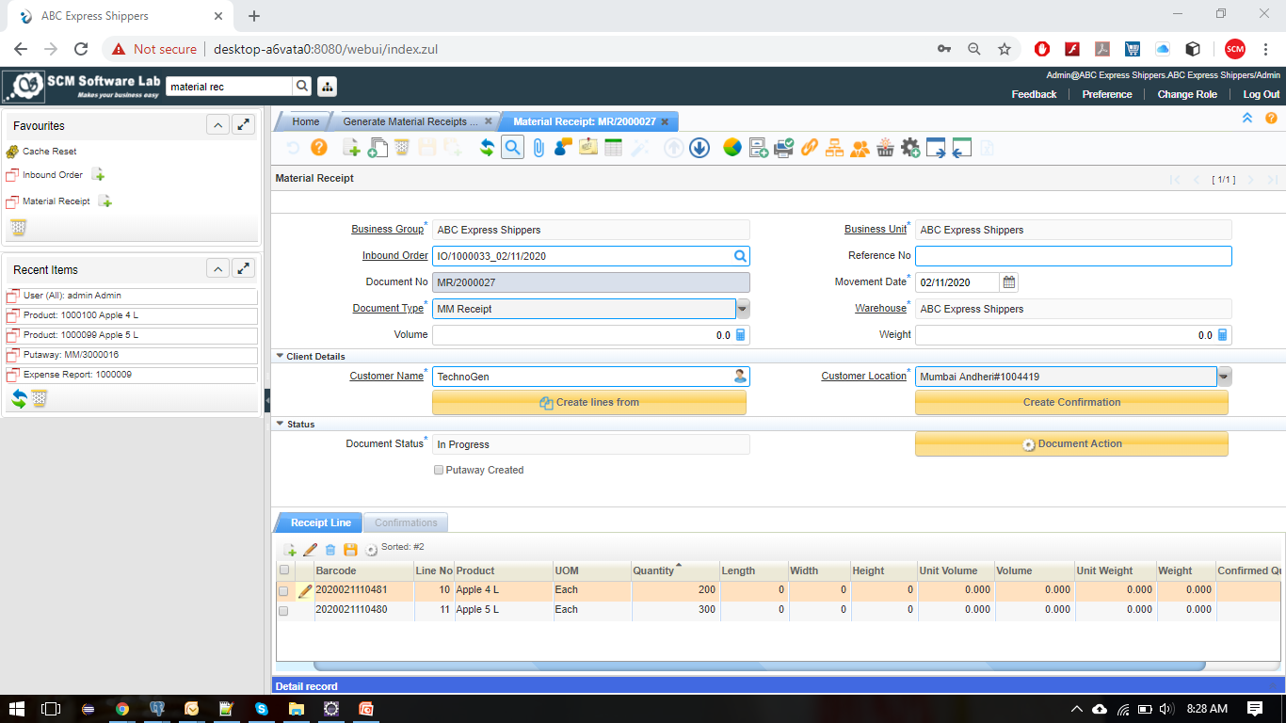
Material Receipt

Slide 13
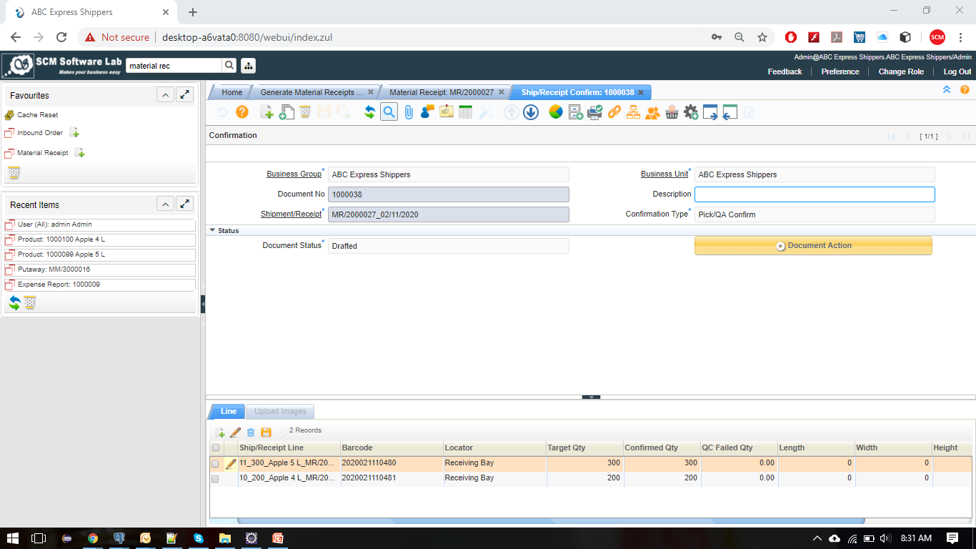
Material Quality Check

Slide 14
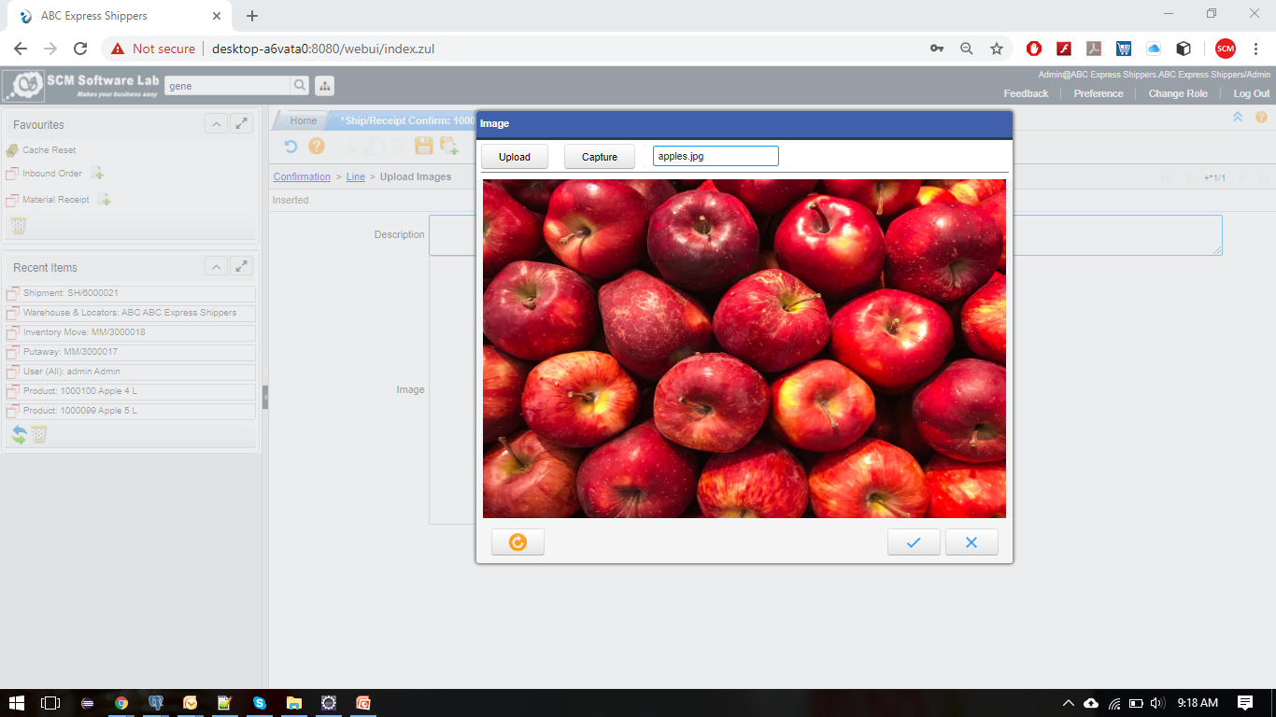
Upload Received Items Images

Slide 15
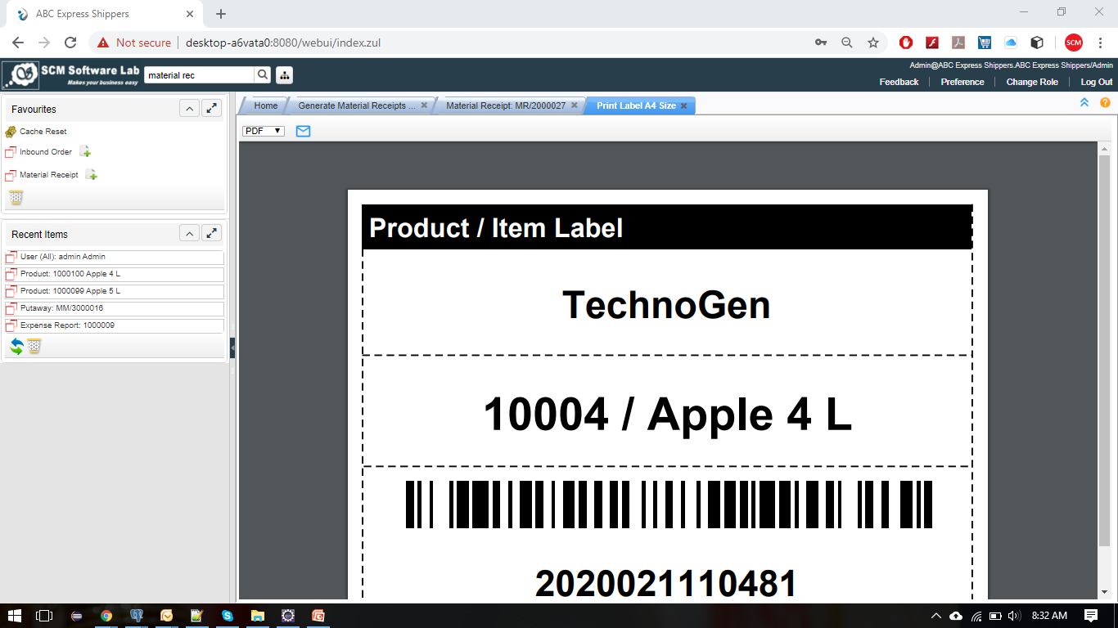
Barcode Generation

Slide 16
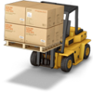
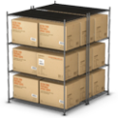
Warehouse Management
05
01
02
03
04
05
Warehouse Zone
Putaway
Inventory Move
Inventory Cycle Count
Replenishment
A warehouse is divided into multiple zones & each Zone have multiple Locators. For ex, case storage and unit storage make separate zones.
After Quality Check, Our Putaway (Auto Bin Allocation) will suggest you the best Locators for moving the Material from Receiving Bay.
Sometimes, we may need to Move Material from one location to another Location. We can use Inventory Movement concept for that.
Inventory cycle count is used for adjusting the quantity in warehouse inventory. Also used for add the opening of the warehouse inventory.
The purpose of replenishment is to keep inventory flowing through the supply chain by maintaining efficient order (Stock Re-Order)

Slide 17
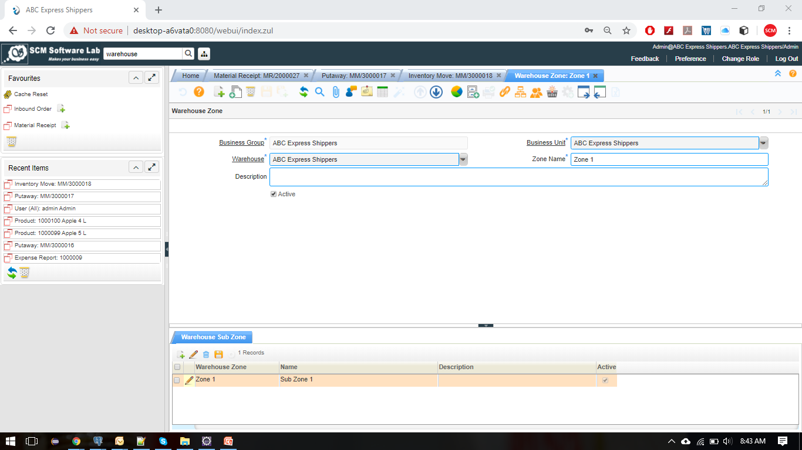
Warehouse Zones

Slide 18
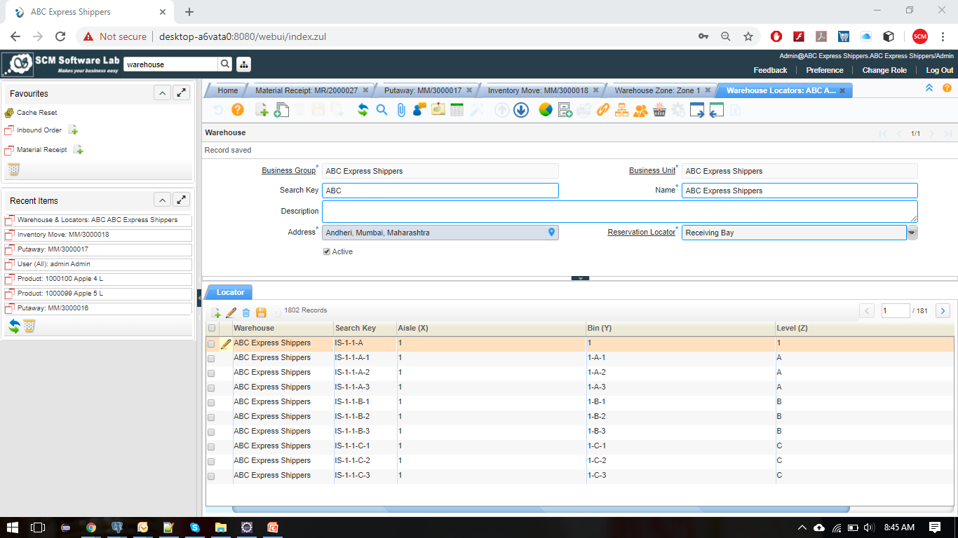
Warehouse Zones

Slide 19
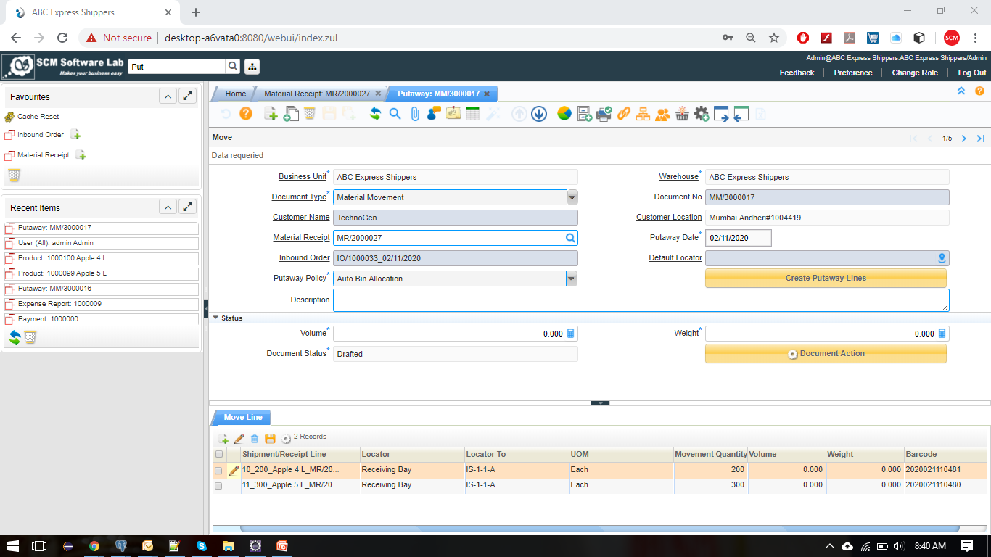
Putaway

Slide 20
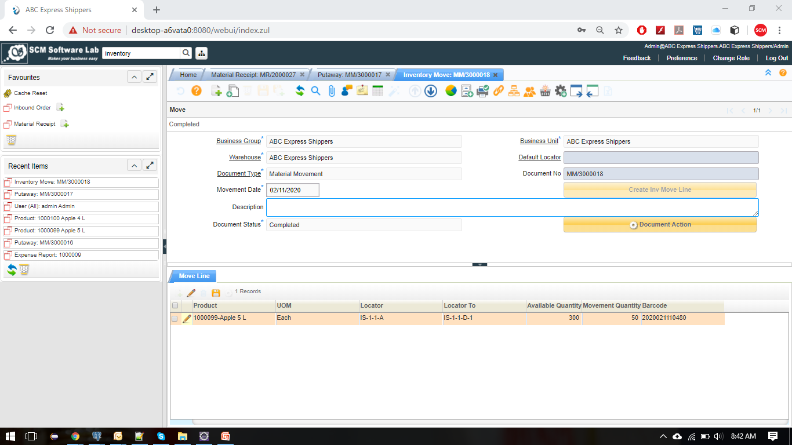
Inventory Move

Slide 21
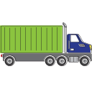
Outbound Operations
05
01
02
03
04
05
Outbound Order
Shipment
Pick & Ship Confirm
Packaging & Labeling
Hand Held Terminal
Customer will raise request you to send their Material from your Warehouse to their Customers. This we called as Outbound Order
A Shipment is defined as a physical outbound movement of goods or materials from the warehouse or it is the issue of physical goods.
Before Shipping the Material, Our system providing two step verification for confirming whether you are sending correct Items or not?
Packaging and labeling is Display of information about a product (Item Names, From etc..) on its packaging or the product itself.
Our System provided the Hand Held Terminal application for Pick and Ship confirmation to scan the Barcodes for correct Items.

Slide 22
Products
Customers
Outbound Operations Architecture
1. Customer will raise request you to send their Material from your Warehouse to their Customers. This we called as Outbound Order
Warehouse
Outbound Order Return
Outbound Order
3. Before Shipping the Material, Our system providing two step verification for confirming whether you are sending correct Items or not?
4. Our System provided the Hand Held Terminal application for Pick and Ship confirmation to scan the Barcodes for correct Items.
Outbound RMA
Pick / Ship Confirmation
6. If shipped Items returned by your Customer's Customer, then Users can Return the Outbound Return on easy way.
2. A Shipment is defined as a physical outbound movement of goods or materials from the warehouse or it is the issue of physical goods.
Vehicle Required for Delivery ?
Shipment / Goods Issue
Goods Delivered to your Customer’s Customer Location
No
Yes
5. Packaging and labeling is display of information about a product (Item Names, From etc..) on its packaging or the product itself.
2.1 Schedule Delivery order will be generated for shipping the material from using company / rented vehicle
Schedule Delivery (Vehicle Management)
Packaging & Labeling
End

Slide 23
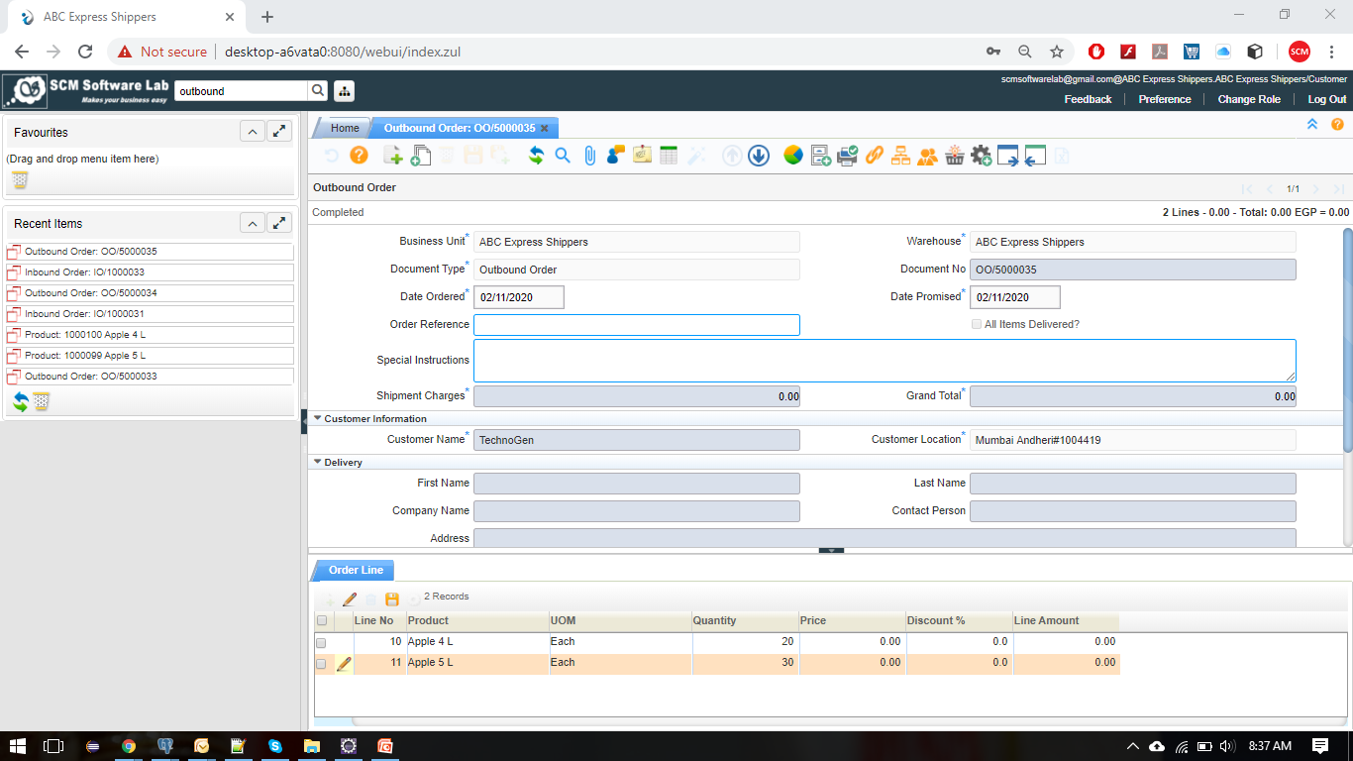
Outbound Order

Slide 24
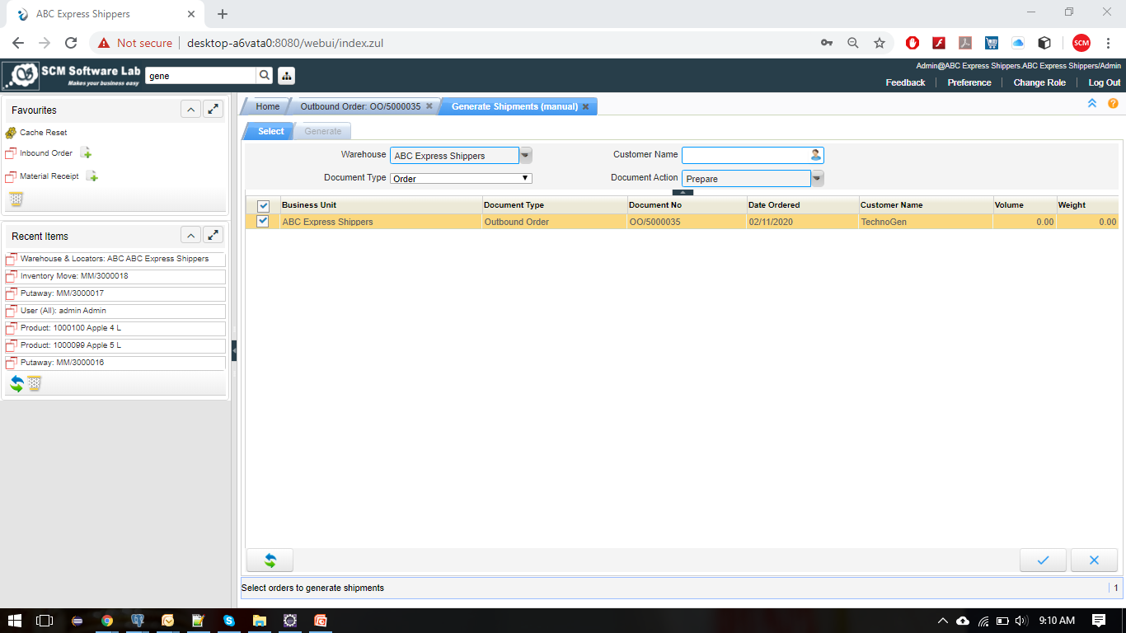
Shipment

Slide 25
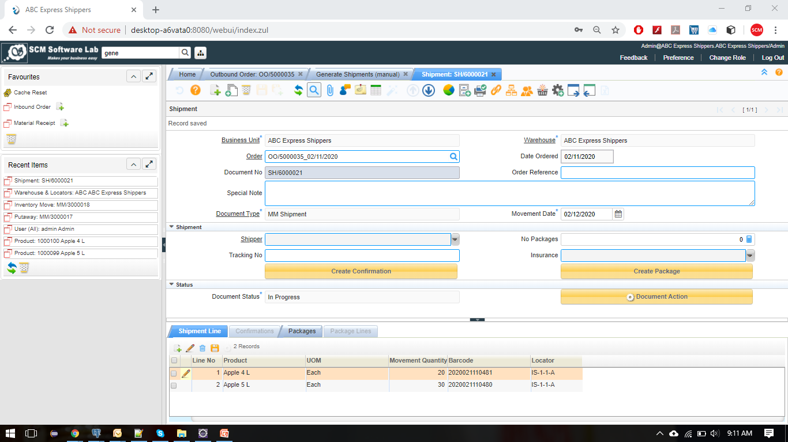
Shipment

Slide 26
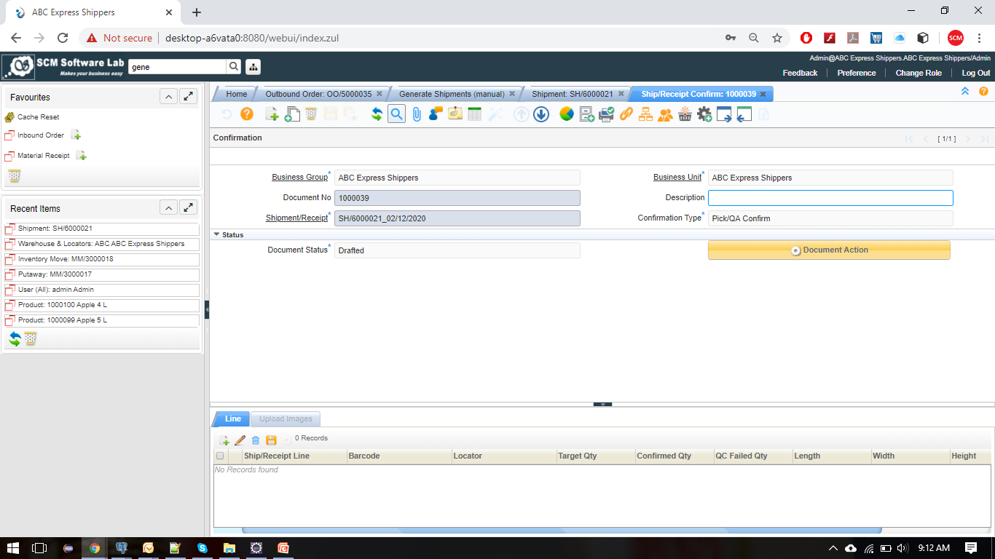
Pick & Ship Confirmation

Slide 27
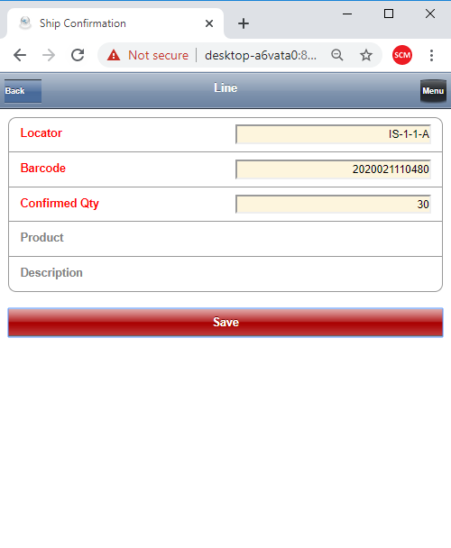
Pick & Ship (Barcode Scanning)

Slide 28
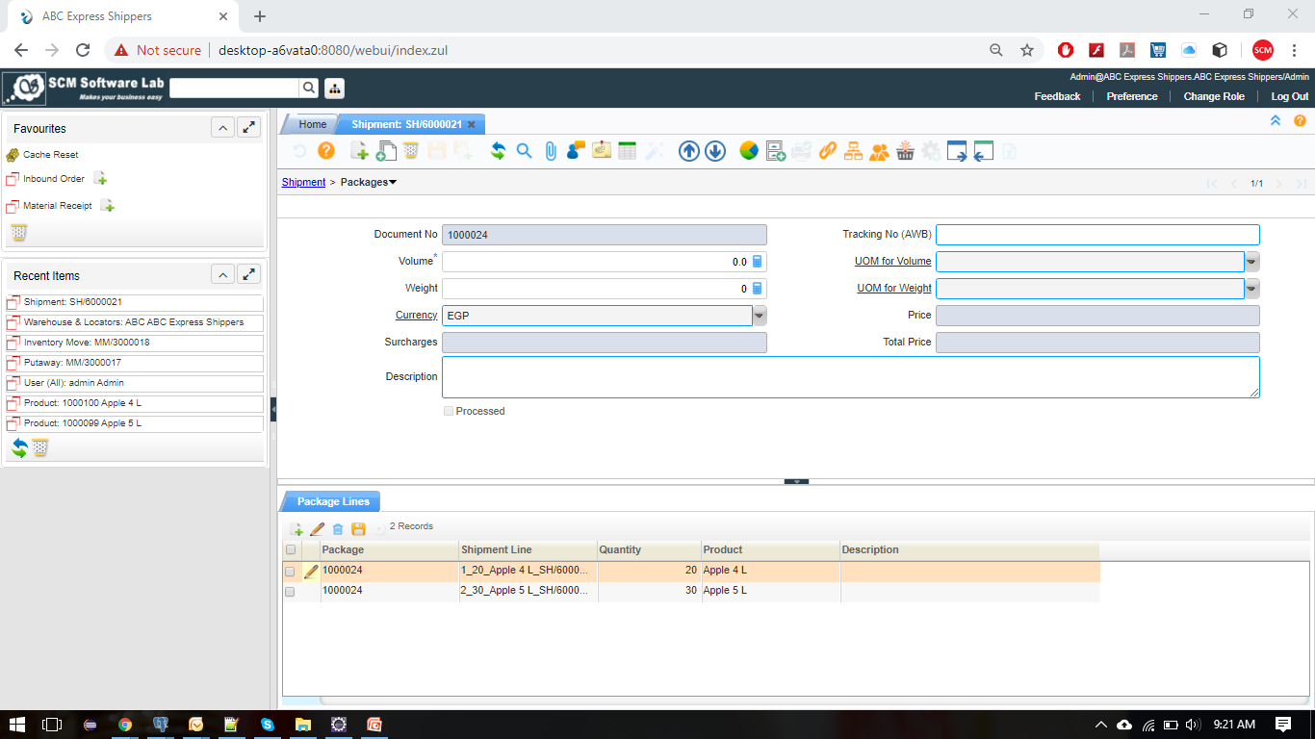
Packing & Labeling

Slide 29
Returns (Inbound / Outbound)
01
02
Inbound Return
Outbound Return
If Received Items don't have quality, Users can Create the Inbound Material Return and can send back to your customers.
If shipped Items returned by your Customer's customer, then Users can create Outbound Return on easy way.

Slide 30
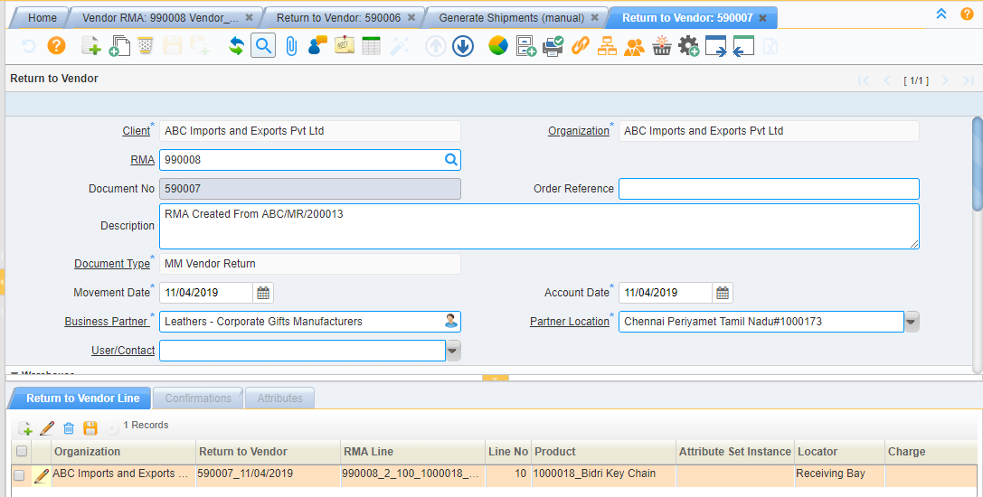
Inbound Material Return

Slide 31
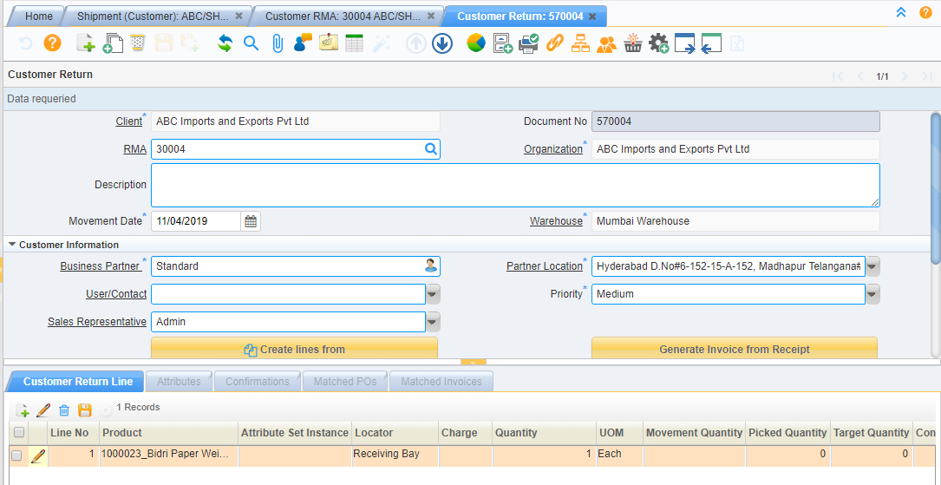
Outbound Material Return

Slide 32
Customer 1
Customer 2
Customer 3
Customer 4
Customer ‘n’
Client Panel
Multi Organization / Branch
Multi Warehouse / Zone
Multi Role
Multi Currency
Multi Language
Workflow based System
Single Cloud Server
Admin Panel
Warehouse Manager
Receiving Supervisor
Quality Control Team
Shipping Supervisor
Accounting Team

Slide 33
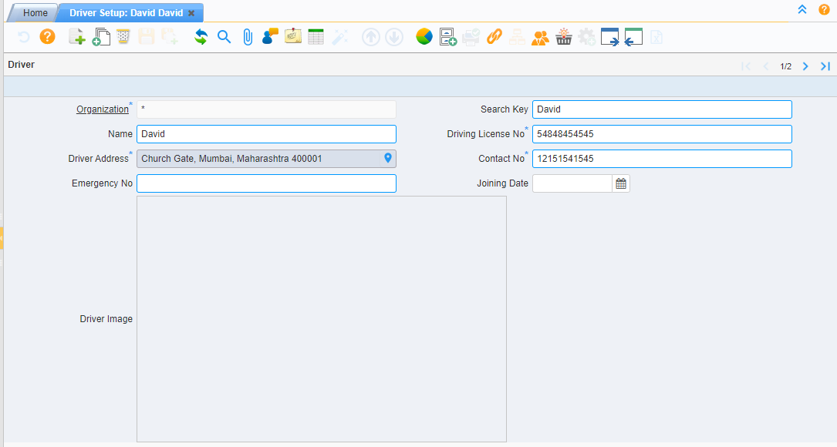
Driver Setup

Slide 34
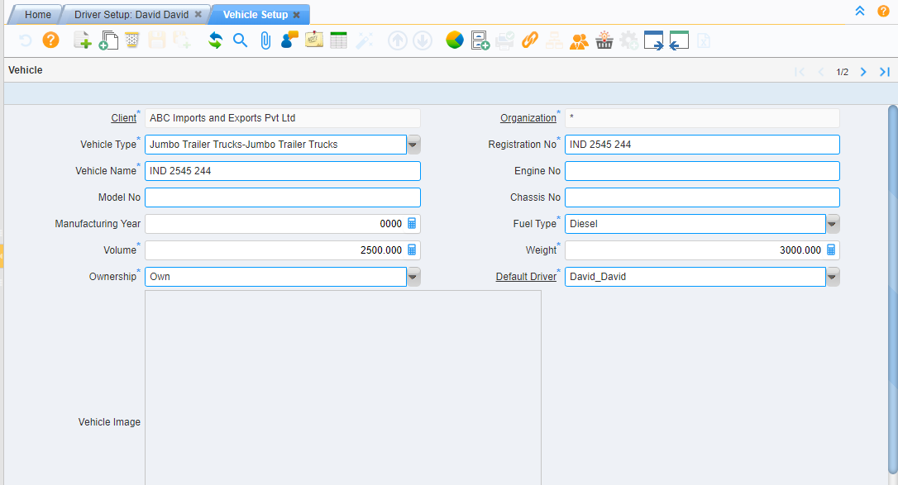
Vehicle Setup

Slide 35
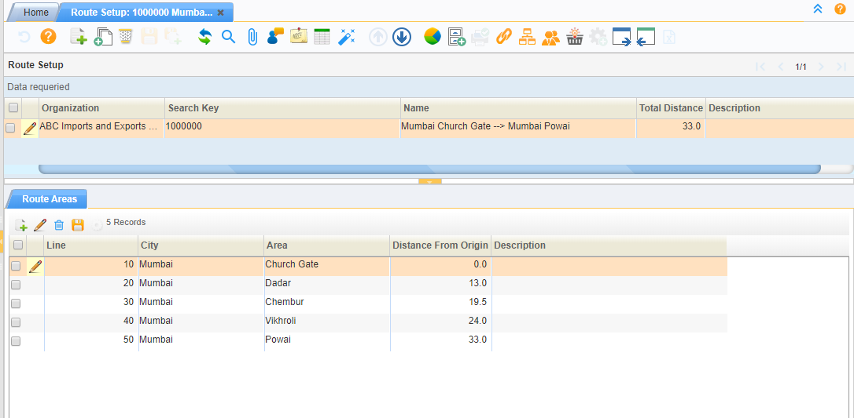
Route Setup

Slide 36
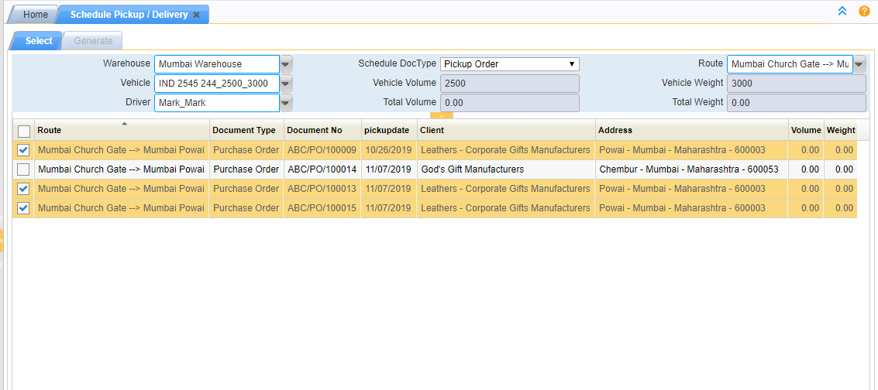
Order Pickup / Delivery

Slide 37
Accounting / Finance
Expense Report
Whatever the services you provided to your Customers, all can be record in Expense Report. For ex, Transportation, Packing etc..
01
Invoice for Client Expenses
02
Whatever the services you have provided to your Customers, we can make single Invoice by using Expense Report on Schedule basis.
Invoice for Storage Utilization
Your Customer's will store their Material on your Warehouse. Based on their Material Volume, Users can make Invoice for all Items.
03
Client Payments
04
User can make single Payment for one Invoice or multiple Invoices. Advanced Payment creation also possible in our system.

Slide 38
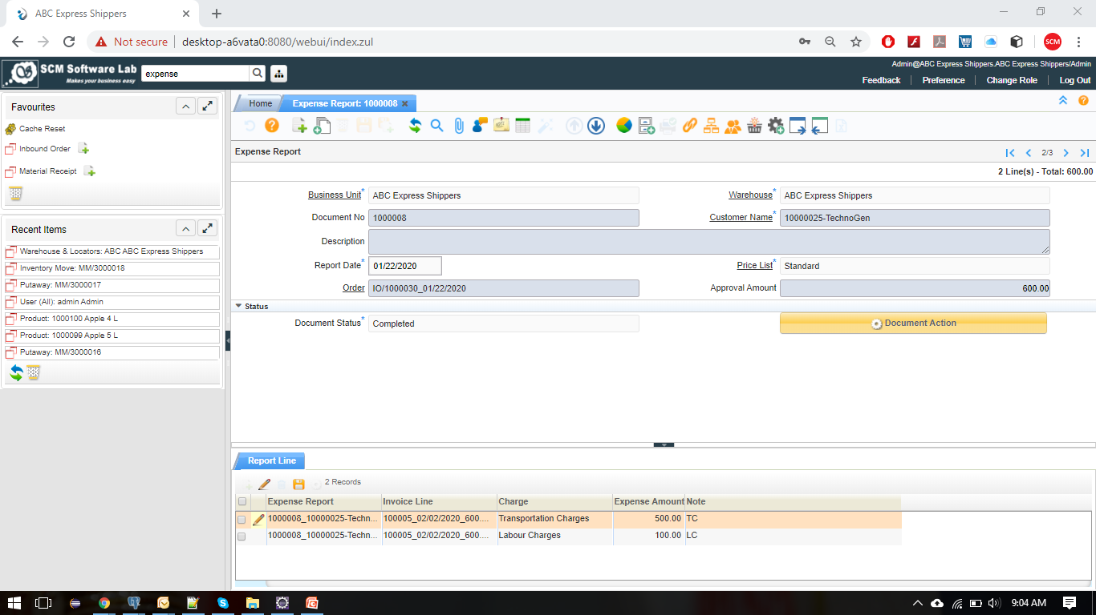
Expense Report

Slide 39
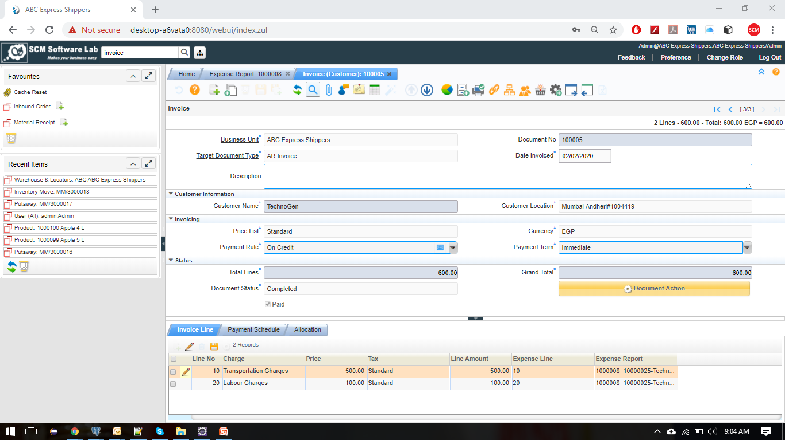
Invoice for Client Expenses / Storage

Slide 40
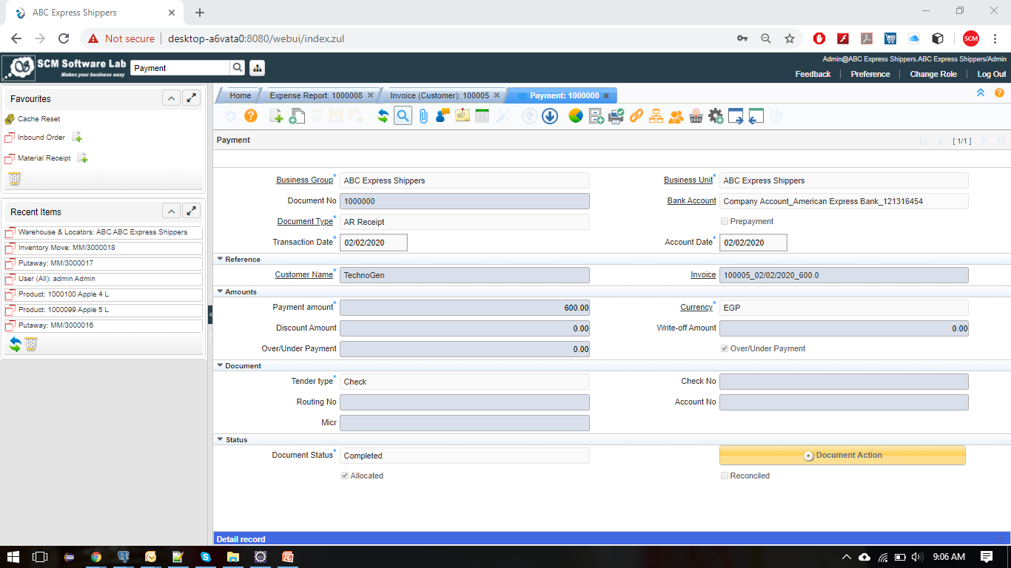
Client Payments

Slide 41
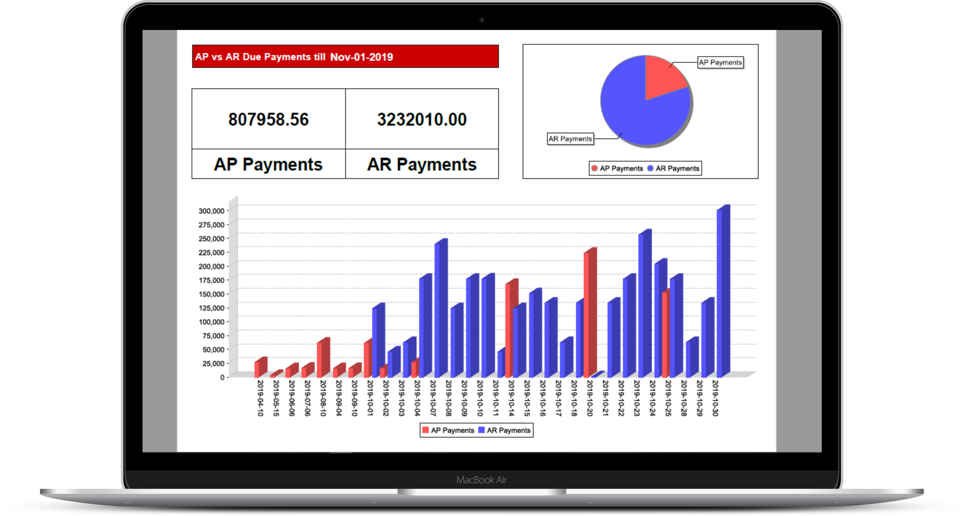
Business Intelligence Reports

Slide 42
Financial Benefits
No Software License Fee
We are not going charging any software license fees. We are just charging what we developed to make a standard ERP
01
No Year Renewal Charges
02
There is no year renewal charges for our software. You can get this software with one time payment .
Low Customization Charges
We are just charging 10 USD per our. If you require any support from us, then only you will pay. Otherwise, no need to pay
03
Unlimited users
04
We are not providing any restrictions on users creation / user access for software.

Slide 43
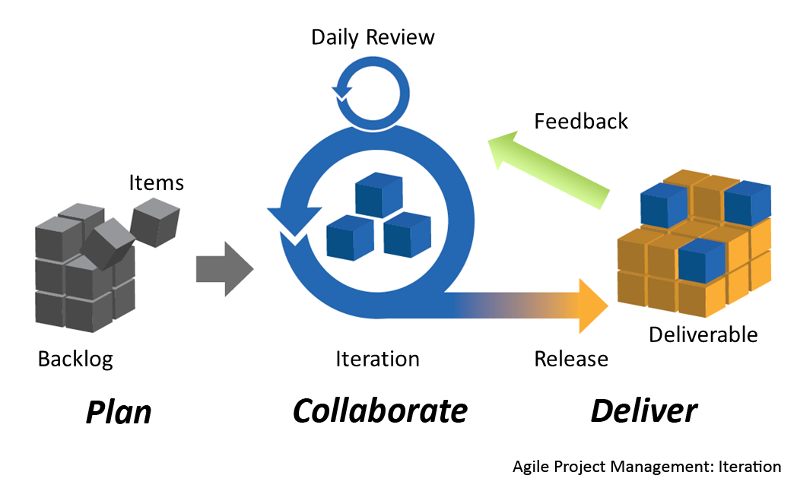
30 – 90 Days Go Live Plan

Slide 44
Some of our Clients

Slide 45
Client Project Details
TransCaribe Shippers Inc, USA (3PL) | TransCaribe Shippers Inc, USA (ERP) | TransCaribe Shippers Inc, USA (Carrier Partner Integration)
We have provided 3PL software to TransCaribe Shippers Inc, USA. TransCaribe is a shipping company with 40+ years of experience. They offer a wide range of shipping and international removals services to both domestic and commercial clients, and no job is too large for them to handle. Following are the main modules covered in software Inbound Operations Warehouse Management System Outbound Operations Material Return Barcode Inventory Management Finance / Accounting Integration with Magaya 3PL Software SMS & WhatsApp Integration | We have provided Trading and Distribution software to TransCaribe Shippers Inc, USA. Following are the main modules covered in software Procurement Planning Warehouse Management System Sales and Distribution Accounting / Finance SMS & WhatsApp Integration | We have developed “Ship Rate Calculator” software for TransCaribe Shippers Inc, USA. Ship Rate Calculator mainly used to calculate the Freight Cost for sending goods from one location to another locations. We have successfully integrated DHL, FedEx & UPS Courier services with our software

Slide 46
Client Project Details
Interbrand SAL, Lebanon (iDempiere ERP Consulting) | Intelex Systems Inc, USA (iDempiere ERP Consulting) | Bluelan Networks Pvt Ltd, India (ERP)
We have provided iDempiere ERP Consulting to Interbrand SAL, Lebanon. Interbrand SAL was established in the 1960s in Dbayeh, Lebanon by the late Andre Tabourian, as the first licensee in the world of Libby McNeil & Libby of Chicago. Interbrand has traditionally been a major player in the juice, ketchup, canned fruits and vegetables categories in Lebanon. Following are the main modules covered in consulting (Technical & Functional) Procurement Planning Warehouse Management System Sales and Distribution Manufacturing Project Management Vehicle Management Barcode Inventory Management Accounting / Finance | We have provided iDempiere ERP Consulting to Intelex Systems Inc, USA. Intelex Systems is a leading technology consulting, IT services and Right sourcing solutions company, delivering technology driven business solutions that meet strategic objectives of our clients. Following are the main modules covered in consulting (Technical & Functional) Procurement Planning Warehouse Management System Sales and Distribution Manufacturing | We have provided Trading and Distribution software to Bluelan Networks Pvt Ltd, India. Bluelan Networks (P) Ltd is a company built on the foundations of IT in the Enterprise. With decades of expertise and unparalleled support, our global clientele count on us to architect and converge resources into maximized productivity. Paramount clientele satisfaction, no less. Our commitment to you is simple, help you grow Procurement Planning Warehouse Management System Sales and Distribution Accounting / Finance

Slide 47
Client Project Details
IEB Solutions, India (ADempiere ERP Consulting) | Fulfillmen, China (3PL) | FwRun, Egypt (3PL)
We have provided ADempiere ERP Consulting to IEB Solutions, India. IEB Solutions offers a comprehensive array of IT Solutions and Services for small, medium to large companies in both the private and public sectors. Following are the main modules covered in consulting Procurement Planning Warehouse Management System Sales and Distribution Manufacturing Project Management Accounting / Finance | We have provided 3PL software to Fulfillmen, China. Fulfillmen is most reliable order fulfillment services from Fulfillmen. Stop Wasting Time on Shipments. You send > We Stock. You Sell > We Ship.We Make Ecommerce Fulfillment Easier For you.Free OMS/WMS Software and Advanced API to connect your sales platforms Following are the main modules covered in software Inbound Operations Warehouse Management System Outbound Operations Material Return Barcode Inventory Management Finance / Accounting | We have provided 3PL software to FwRun, Egypt. Fwrun is a full-service order fulfillment company. We are dedicated to providing our customers the best drop shipping and order fulfillment experience possible. Enabling them to reach new markets. Following are the main modules covered in software Inbound Operations Warehouse Management System Outbound Operations Material Return Barcode Inventory Management Finance / Accounting

Slide 48
Thank You!
Q & A ?

